Slide 1

EDUCATING ESPAÑA
A data-driven analysis of our client’s position in the Madrid educational publishing market

Slide 2

THE PROJECT
To predict which teachers chose to change their textbook publisher, based on marketing, commercial visits and other data.

Slide 3


Welcome Orientation Agenda
Market Trends
Our Company
Findings and Results
Business Recommendations
3

Slide 4


THE MARKET
4

Slide 5
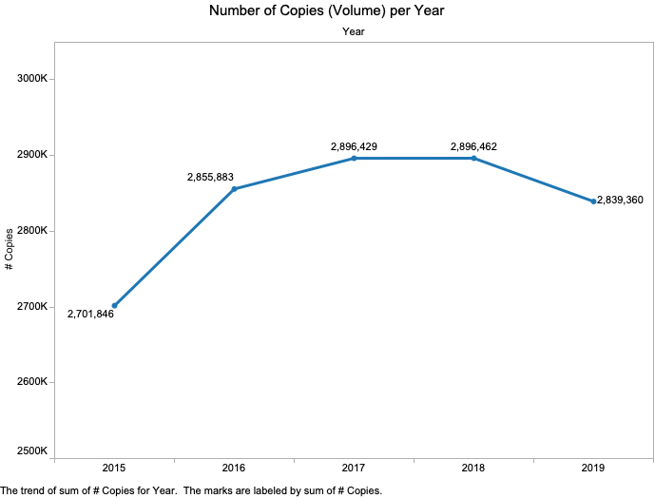

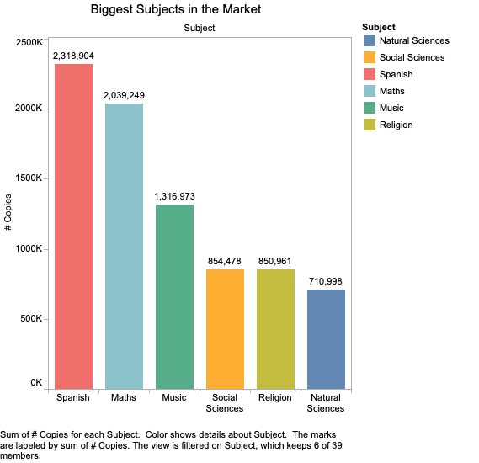
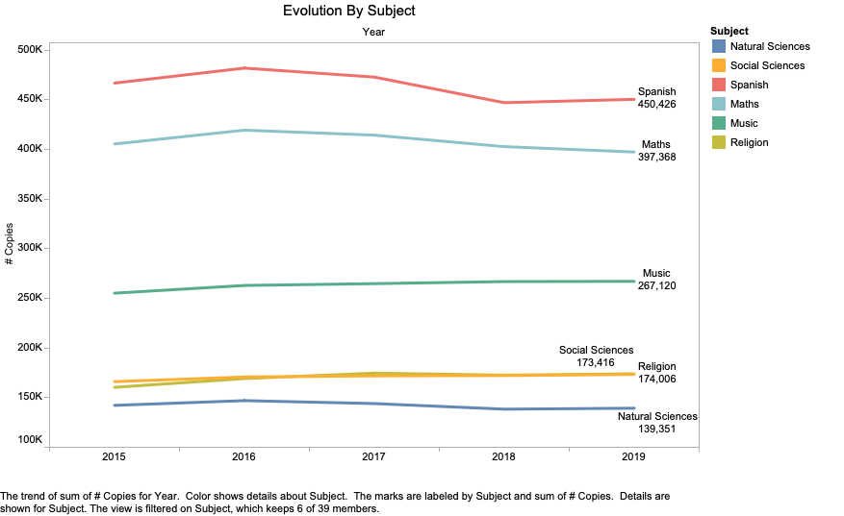
First Class Market Movements
Market dropping after a rise
Spanish: grande Natural Sciences: pequeño
Subject evolution? No change
5

Slide 6
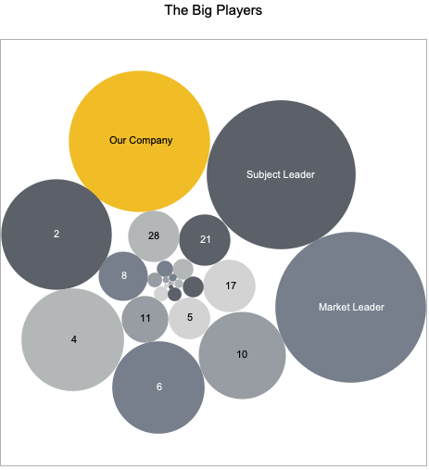

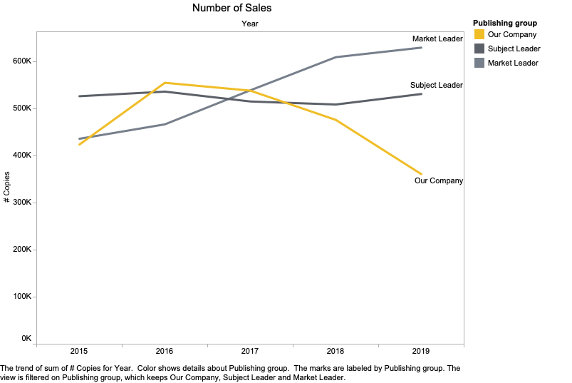
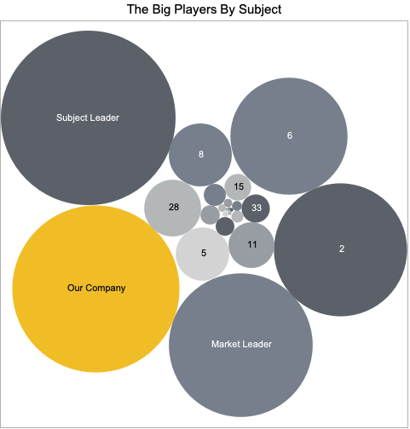
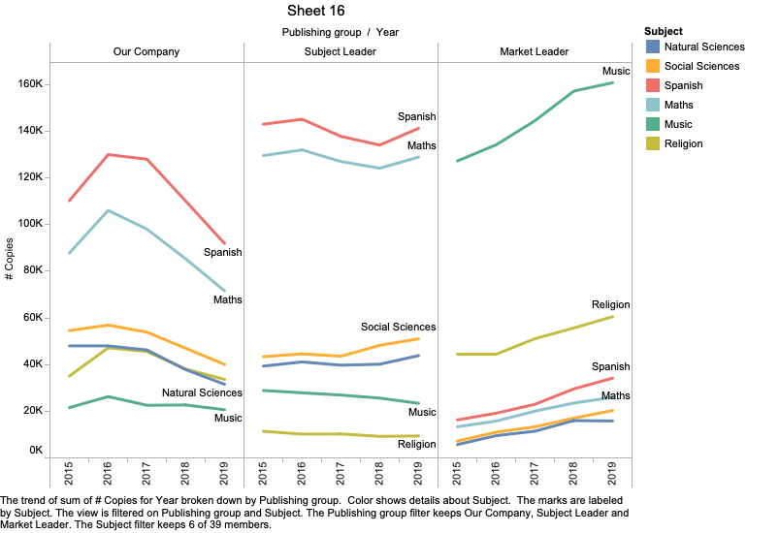
Second Class Our Position
Where we are
We’re 3rd in the market
2nd in the 6 subjects
The bad news
We’ve been losing ground
even in our strengths
6

Slide 7

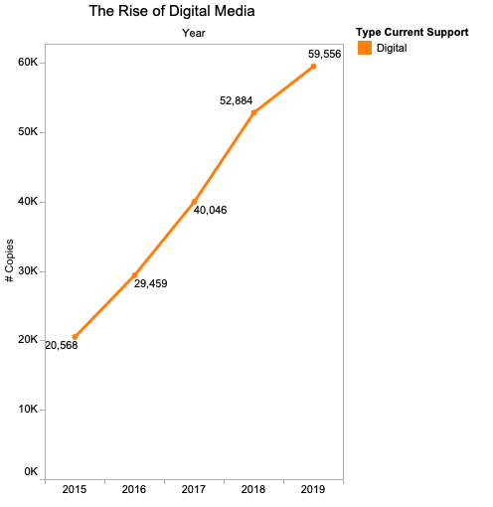
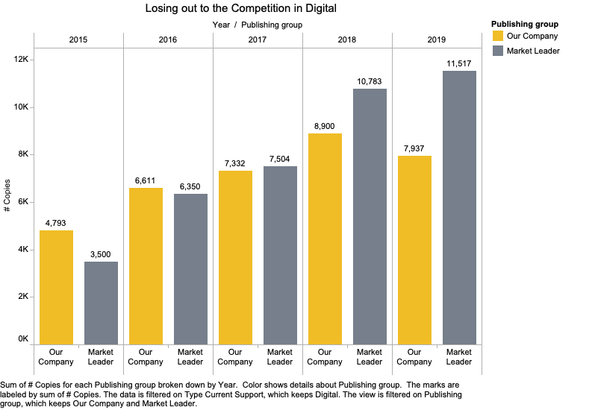
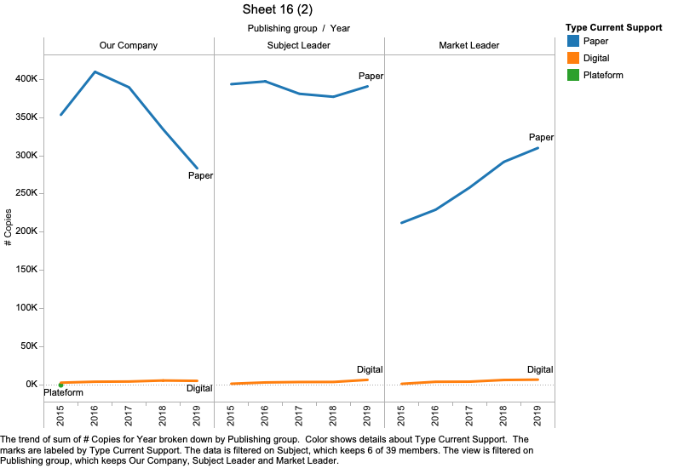
Break Time The Rise of Digital
Digital Media has been growing fast!
And we are being completely left behind in it
But its still tiny compared to Paper (which we are also losing in)
7

Slide 8

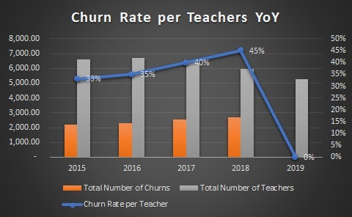
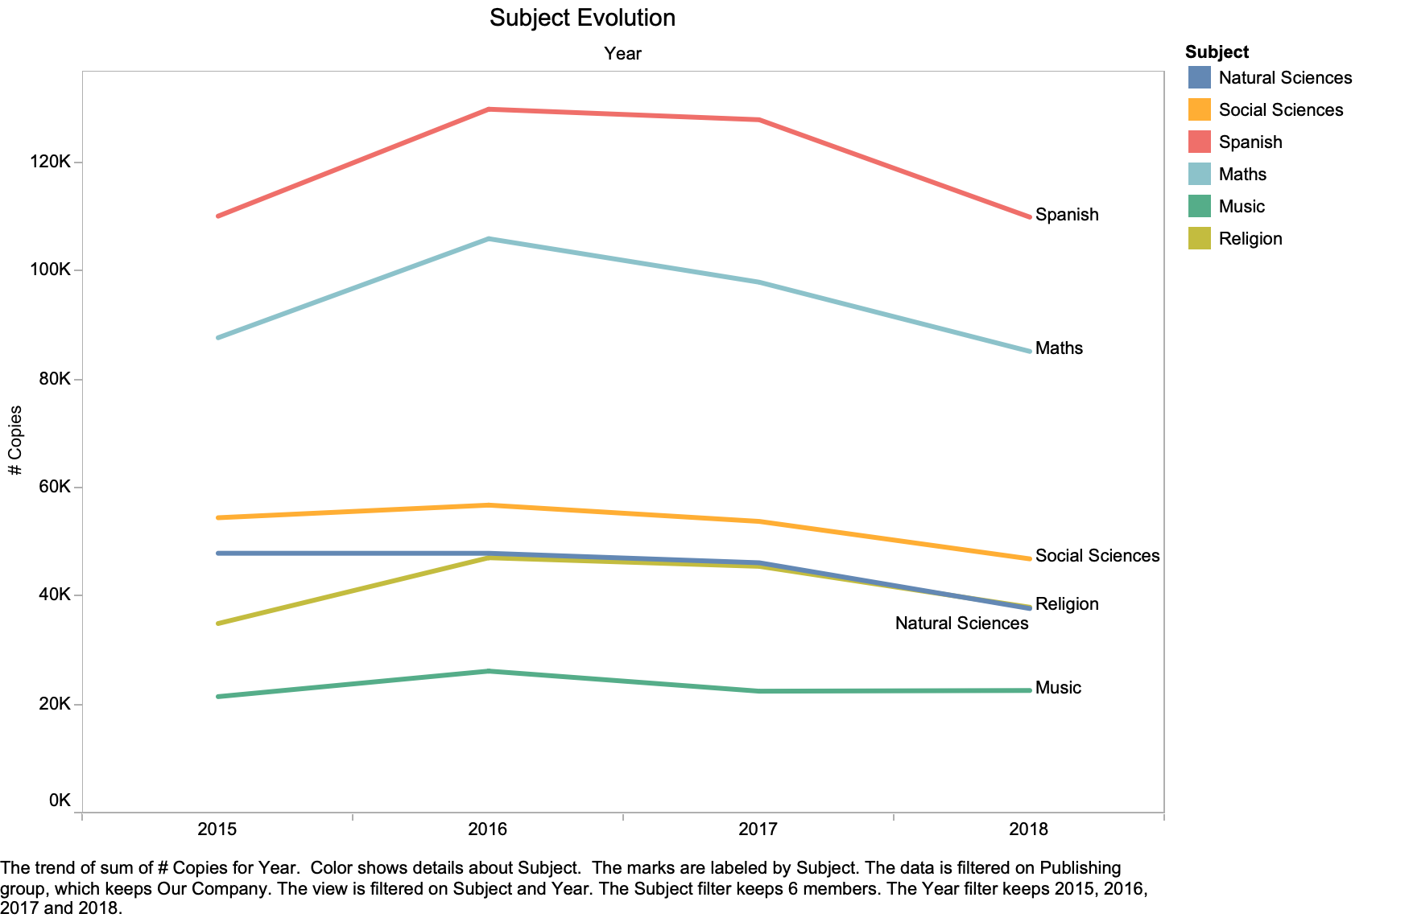

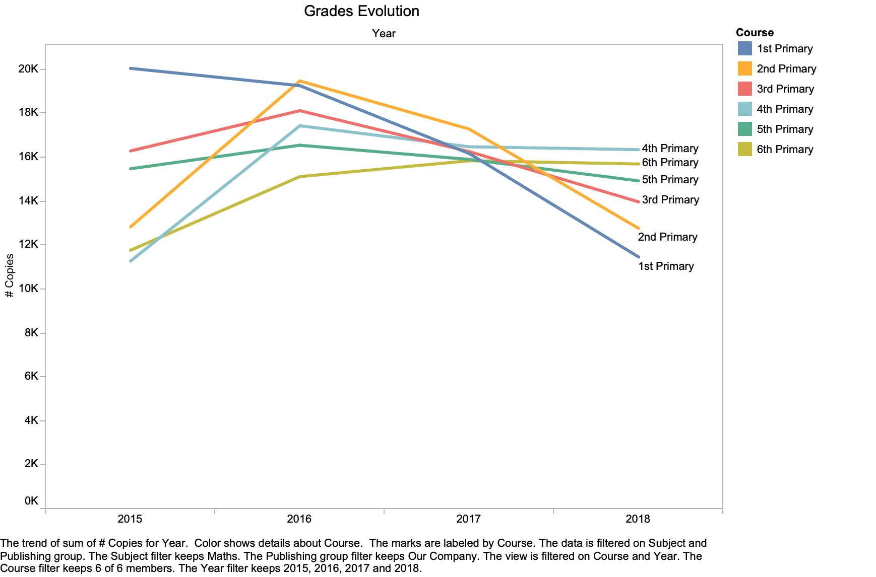

Break Time Drilling Deeper - problems
Our churn rate has been rising
Spanish & Maths have been dropping specifically
1st and 2nd Primary are fastest dropping
8

Slide 9


FEATURE ENGINEERING
9

Slide 10

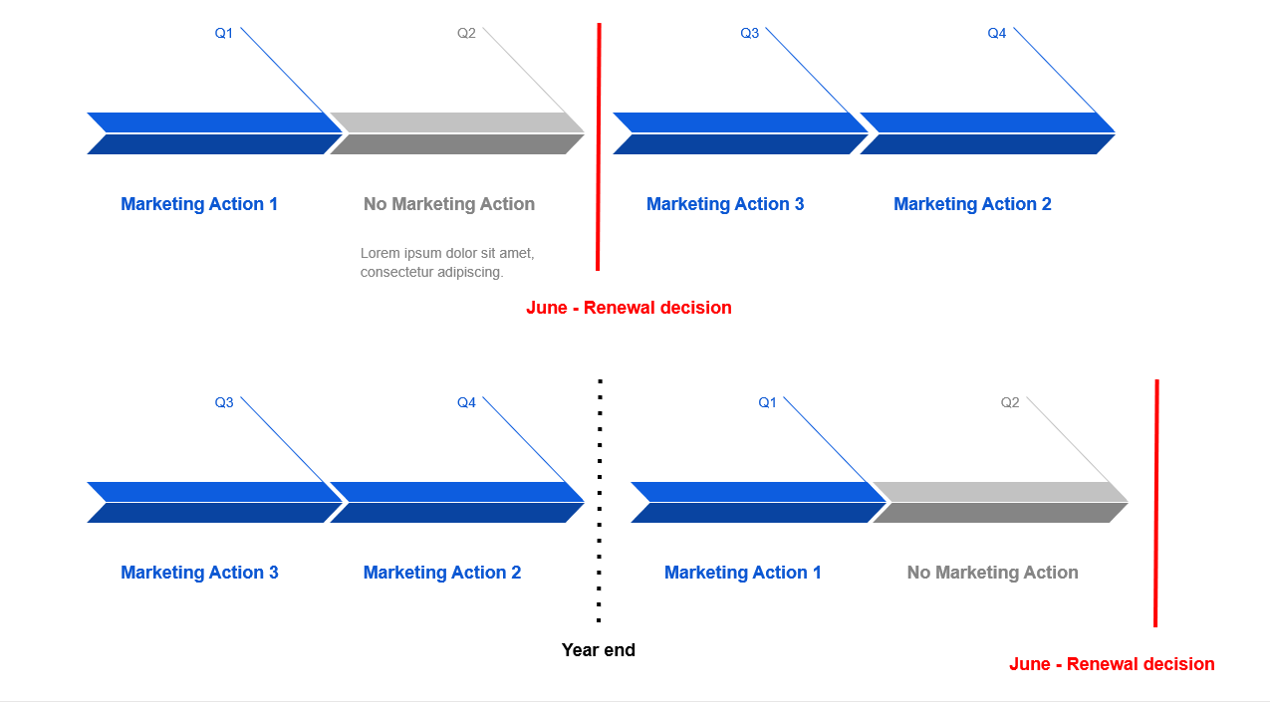
Third Session Feature Engineering 1 - Marketing
3 Marketing Campaigns
Positive and Negative numbers
Many marketing events on same day for one client
Each one has an optimal season:
Marketing Action 1 in H1
Marketing Actions 2 & 3 in H2
*************************
Created a feature for ‘in-season’
and ‘out of season’ marketing
Sum of all marketing
Count of marketing actions
10

Slide 11

Third Session Feature Engineering 2 - Coverage
Coverage contains data around visits to the various schools by a company representative
Merged school location and coverages and filtered the Region to Madrid.
For each ´Customer heading´ we added the years from 2015 to 2019 and the column count rep: this column counts how many representatives a school has had from year 2011 to that year.
Titularity: replace NaN and 0 by the mode: Public
Concatenated all the years
Create dummies for Titularity
11

Slide 12
Third Session Feature Engineering 3 - Activities
11 different activities in 34 different departments
Dummified the categorical variables
New variable that count the number of departments the activity has been performed in the same day
Our objective was to find out if the activities performed in the department were relevant for the churn of the school
12

Slide 13


THE MODEL
13

Slide 14


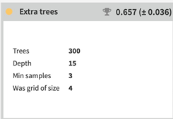
School Lunch – Entrée The Model-Subject Math with grade 1º and 2º
Model used: Extra Trees – Extra Random
Score with ROC AUC: 0.657
Unused features: regional language, mk2 in season, subject, masterid, mk1 out of season, ownershipteam, course, in-house training sum, year
Feature importance: institution, number of representatives and mk2 sum.
14

Slide 15
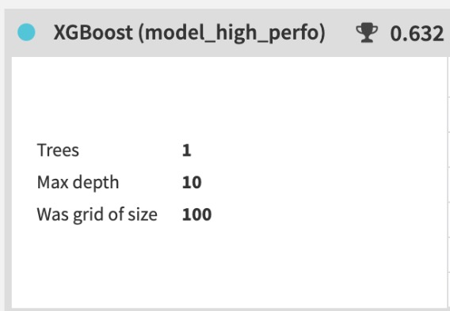
School Lunch – Main Course The Model-Subject Social Science with grade 1º and 2º
Model used: XGBoost – Long May She Reign
Score with ROC AUC: 0.632
Unused features: regional language, masterid, longitude, latitude
Feature importance: nº of copies, mk1 in season, nº of marketing actions, mk2 sum, mk2 out of season
15

Slide 16

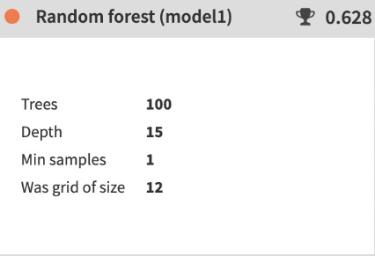
School Lunch - Dessert The Model-Subject Spanish with grade 1º and 2º
Model used: Random Forest – Run Forest Run
Score with ROC AUC: 0.628
Unused features: masterid, longitude, latitude
Feature importance: nº of copies, total sum, nº of marketing actions, mk2 out of season, count_rep, mk sum
16

Slide 17

Why did we choose AUC-ROC? Binary Classification Problem Also tried with F1, Accuracy Optimal threshold provided by Dataiku
Exam Time Assessing the Model

Slide 18


THE FUTURE
18

Slide 19



Afternoon Games Recommendations
We need more granular marketing data to make better predictions
Use data from other regions to help understand the behavior
The graphs showed that we were leaders in digital.
Focus on 1º and 2º primary book content
Increase the marketing actions in the optimal period
Start a focus on music – investment 3º subject in Madrid
19

Slide 20


ANY QUESTIONS?

